Slide 1
S.O.L.I.D Principles
By: Waleed Nouman

Slide 2
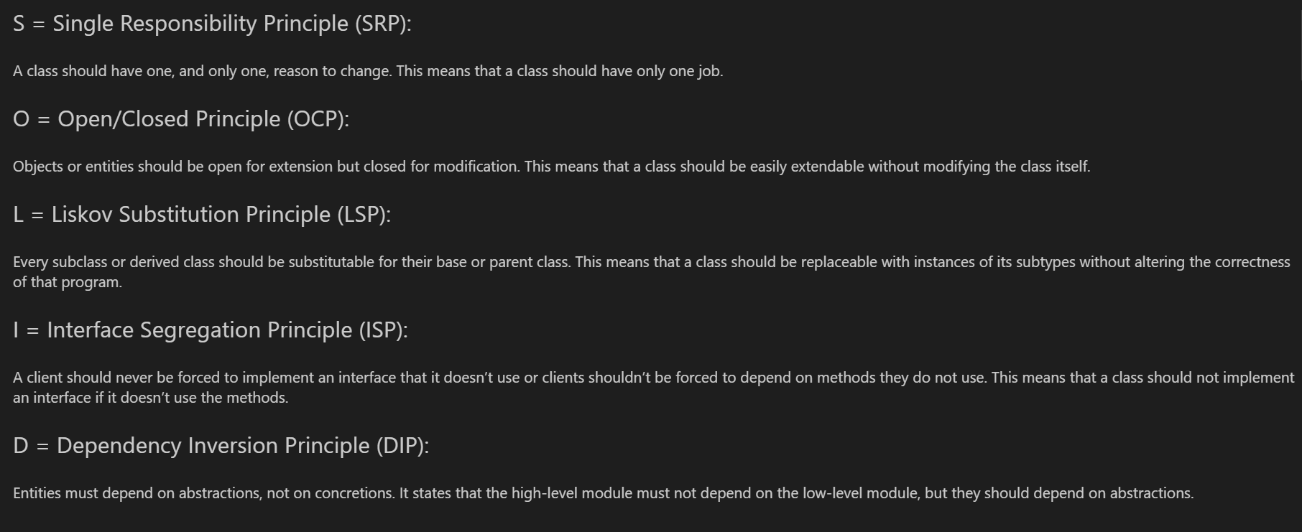

Slide 3

Single Responsibility Principle
Imagine a chef who is responsible for only one task: making pizza. This chef only focuses on kneading the dough, adding toppings, and baking it to perfection.
He doesn’t get involved in making salads, desserts, or drinks. By focusing on just one task, the chef becomes an expert in making delicious pizzas.
As the saying goes “too many cooks spoil the broth”

Slide 4
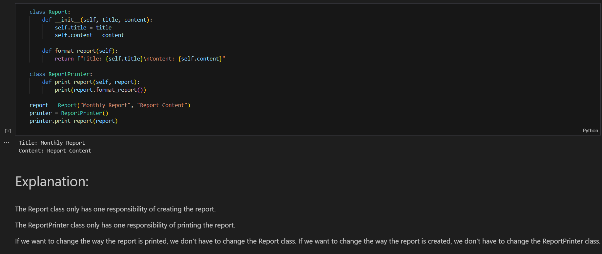

Slide 5
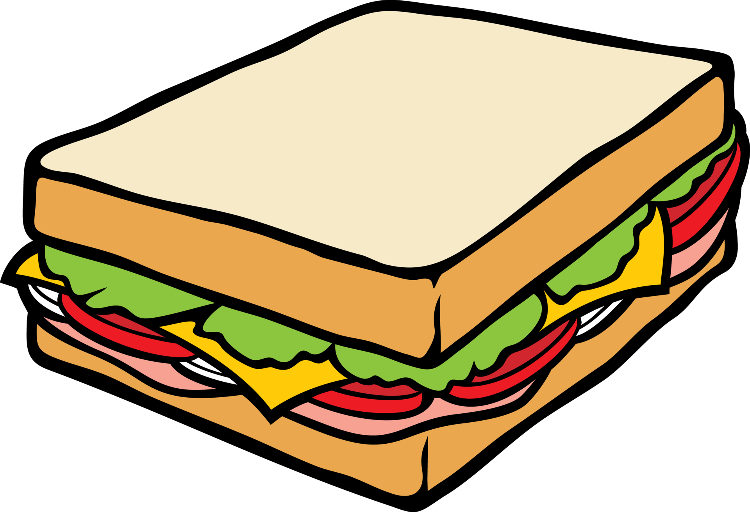
Open/Close Relationship Principle
Consider a sandwich shop that offers a variety of base sandwiches.
Customers can customize their sandwiches by adding extra ingredients without changing the basic sandwich recipes.
The shop can introduce new ingredients, but the original recipes remain untouched.

Slide 6
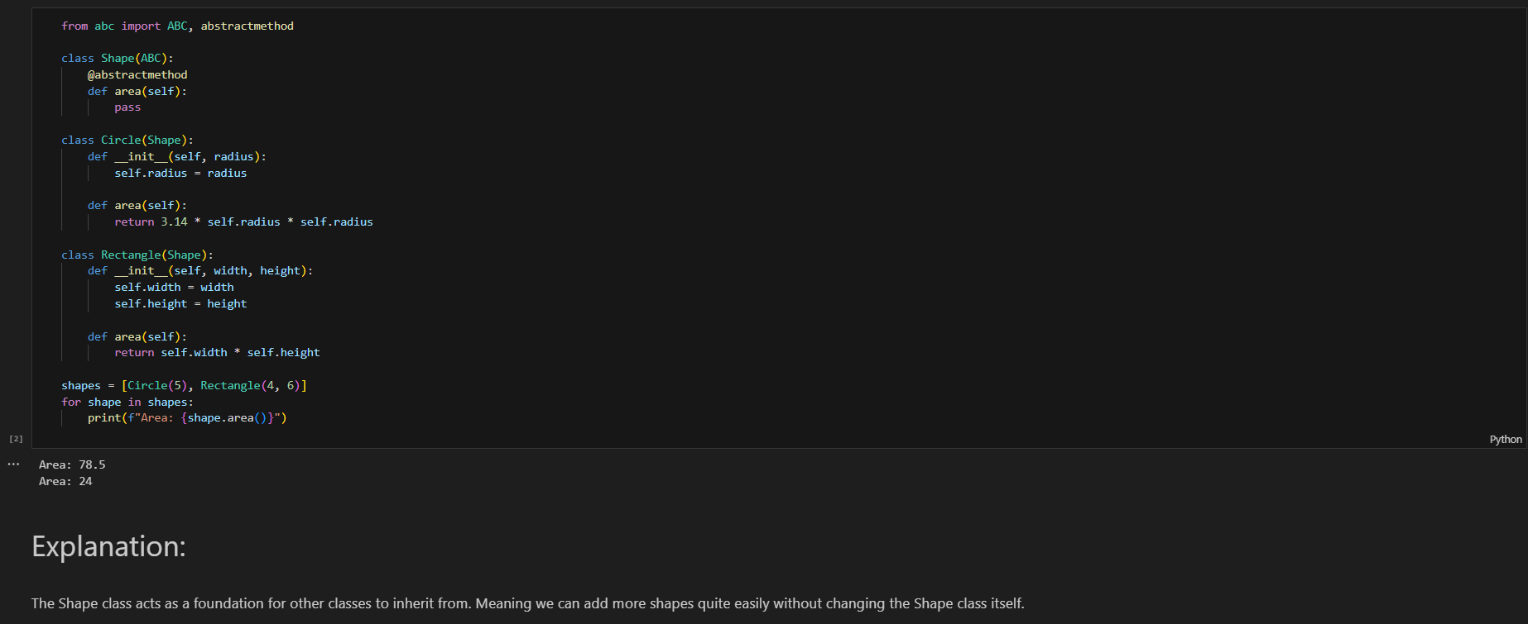

Slide 7

Liskov Substitution Principle
In a smoothie bar, you can replace any type of fruit in your smoothie (like swapping strawberries for blueberries) without affecting the process of making the smoothie or the final product's quality.
The smoothie maker still works with any fruit you choose.

Slide 8
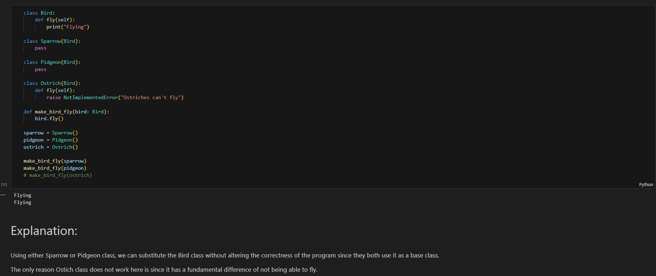

Slide 9

Interface Segregation Principle
Imagine a large kitchen with specialized stations: a grill station, a salad station, and a dessert station.
Each station has specific tools and tasks. The grill station doesn’t need the tools for making desserts, and the dessert station doesn’t need the grill tools.

Slide 10


Slide 11

Dependency Inversion Principle
Think of a chef who relies on a grocery store to supply ingredients.
Instead of the chef needing specific brands or types of ingredients (like Brand A tomatoes), the grocery store ensures it provides high-quality ingredients (any brand) that meet the chef’s needs.
The chef’s recipes depend on high-quality ingredients, not on specific brands.

Slide 12


Slide 13

Thank You
Any Questions?

